Slide 1


This leaflet can be made available in a range of formats. Please ask someone if you need a different format.
Thank you.
HAVE YOUR SAY
How to make a compliment,
comment, complaint and suggestion.
Information for clients, carers and families.
SEA Recruitment Services Ltd
Downs Court Business Centre
29 The Downs
Altrincham
Cheshire
WA14 2QD
E-mail: info@searecruitment.co.uk
Web: www.searecruitment.co.uk
Tel: 0161 928 8810
Fax: 0161 332 7732
Text: 07595 917 403 (voice or SMS)
Company Ltd by Guarantee No
VAT No 995 2375 73
Notes:
1

Slide 2


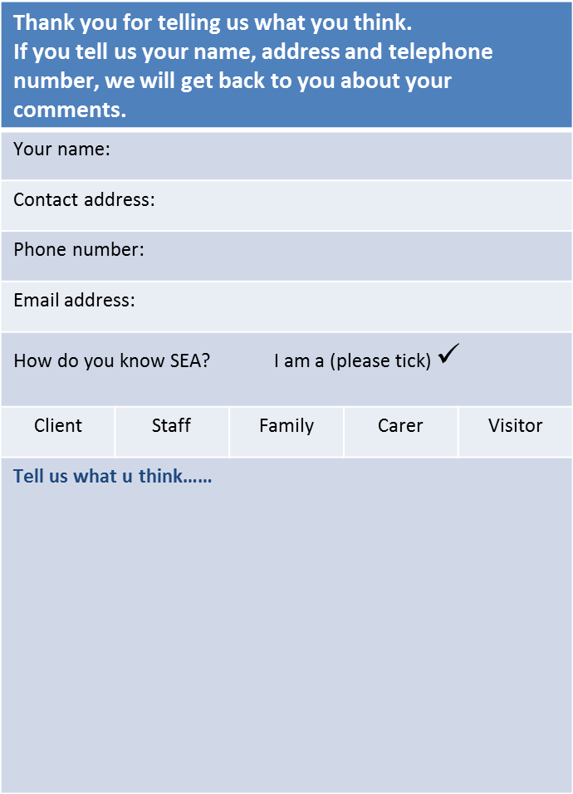


Please tell us if you are……
Complaint/Compliment/Suggestions Form
Happy with someone or something that has
happened to from SEA
Not happy with someone or something that has happened to from SEA
How to tell us……
You can fill out a client survey.
This form asks questions about your time with SEA
Date:
Thank you.
You can fill out a Suggestion Form and pass to your key worker
Or, you can email us at info@searecruitment.co.uk

Slide 3

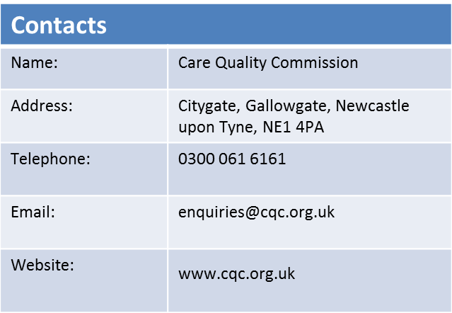
If you tell us your name and telephone number, we will get back to you to talk about your comments.
Remember if you are not happy about something there is always someone there to listen & help.
If you want, you can ask a friend or relative to tell us what you think.
We will do our best to help.
If you are not happy with what you are told, you can make a complaint by writing a letter or by email. The letter or email should be sent to the Directors of SEA, post and email address are on the next page.
Ask if you need someone to help to write a letter or email
SEA will write back to you to tell you what they have found within 20 working days of receiving your letter or email.
If it takes longer to find out what has happened, we will let you know.
You can also send your letter to the Care Quality Commission who can help you with your complaint or concerns. Their address is on the next page.

